Slide 1
AIML Assignment

Slide 2
PART A: CLASSIFICATION

Slide 3
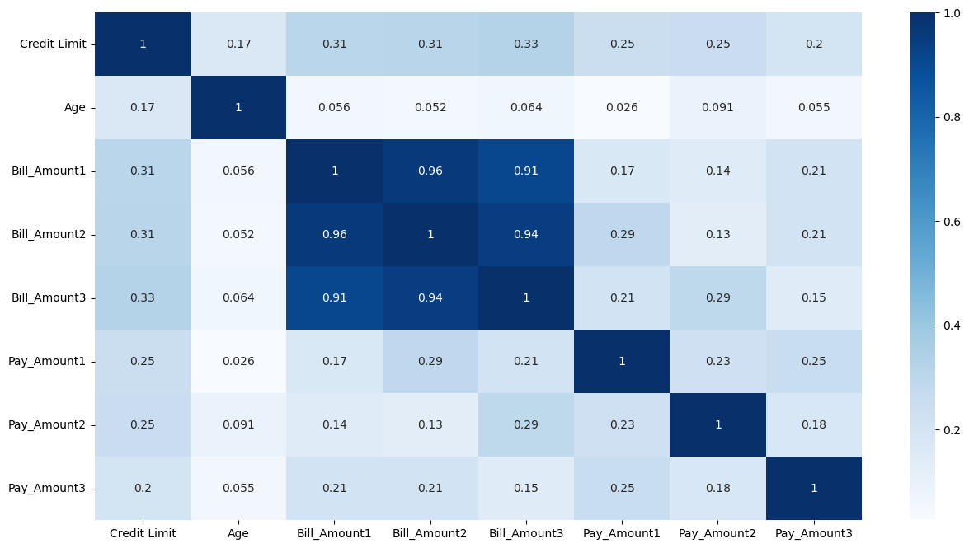

EDA

Slide 4
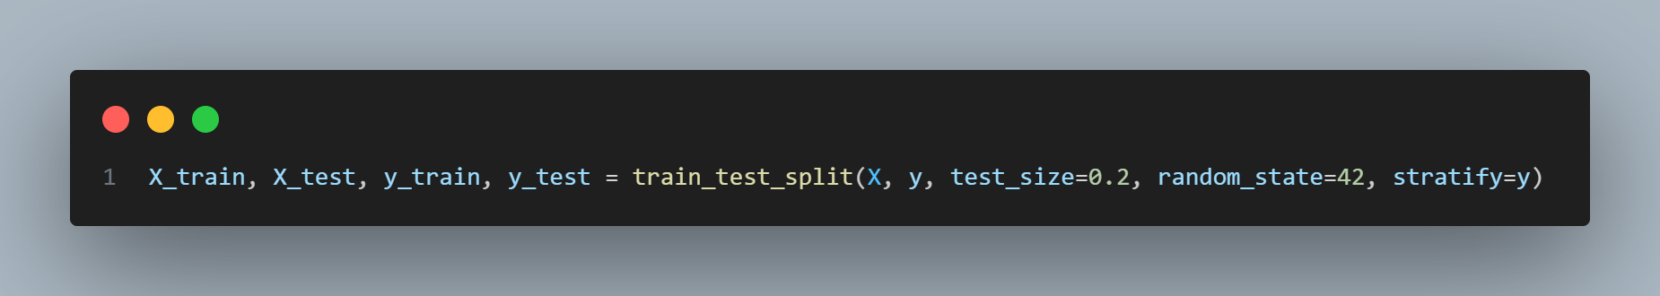
How is your prediction task defined? And what is the meaning of the output variable?
In the context of the given classification problem, we have a set of features that include 'Credit Limit', 'Education', 'Age', 'Bill_Amount1', 'Bill_Amount2', 'Bill_Amount3', 'Pay_Amount1', 'Pay_Amount2', and 'Pay_Amount3’, ‘Gender’, ‘Marriage Status’ . These features represent various attributes of individuals for predicting the likelihood of defaulting on payment in the next month.
The data is split into two variables: X (features) and y (target variable). X contains the features, while y contains the target variable.
To evaluate the models' performance, the data is further divided into training and testing sets using sklearn’s train_test_split function. The training set is used to train the models to learn the patterns and relationships between the features and the target variable. The testing set is used to assess how well the trained models generalize to unseen data.
The objective of training these models is to predict the value of the target variable (y) based on the given features (X). The output of the models would be the expected value of the target variable (0 or 1) given the values of the features.
By training and evaluating different classification models using these features, we aim to identify the most effective model that can accurately predict whether an individual is likely to default on payment in the next month.

Slide 5
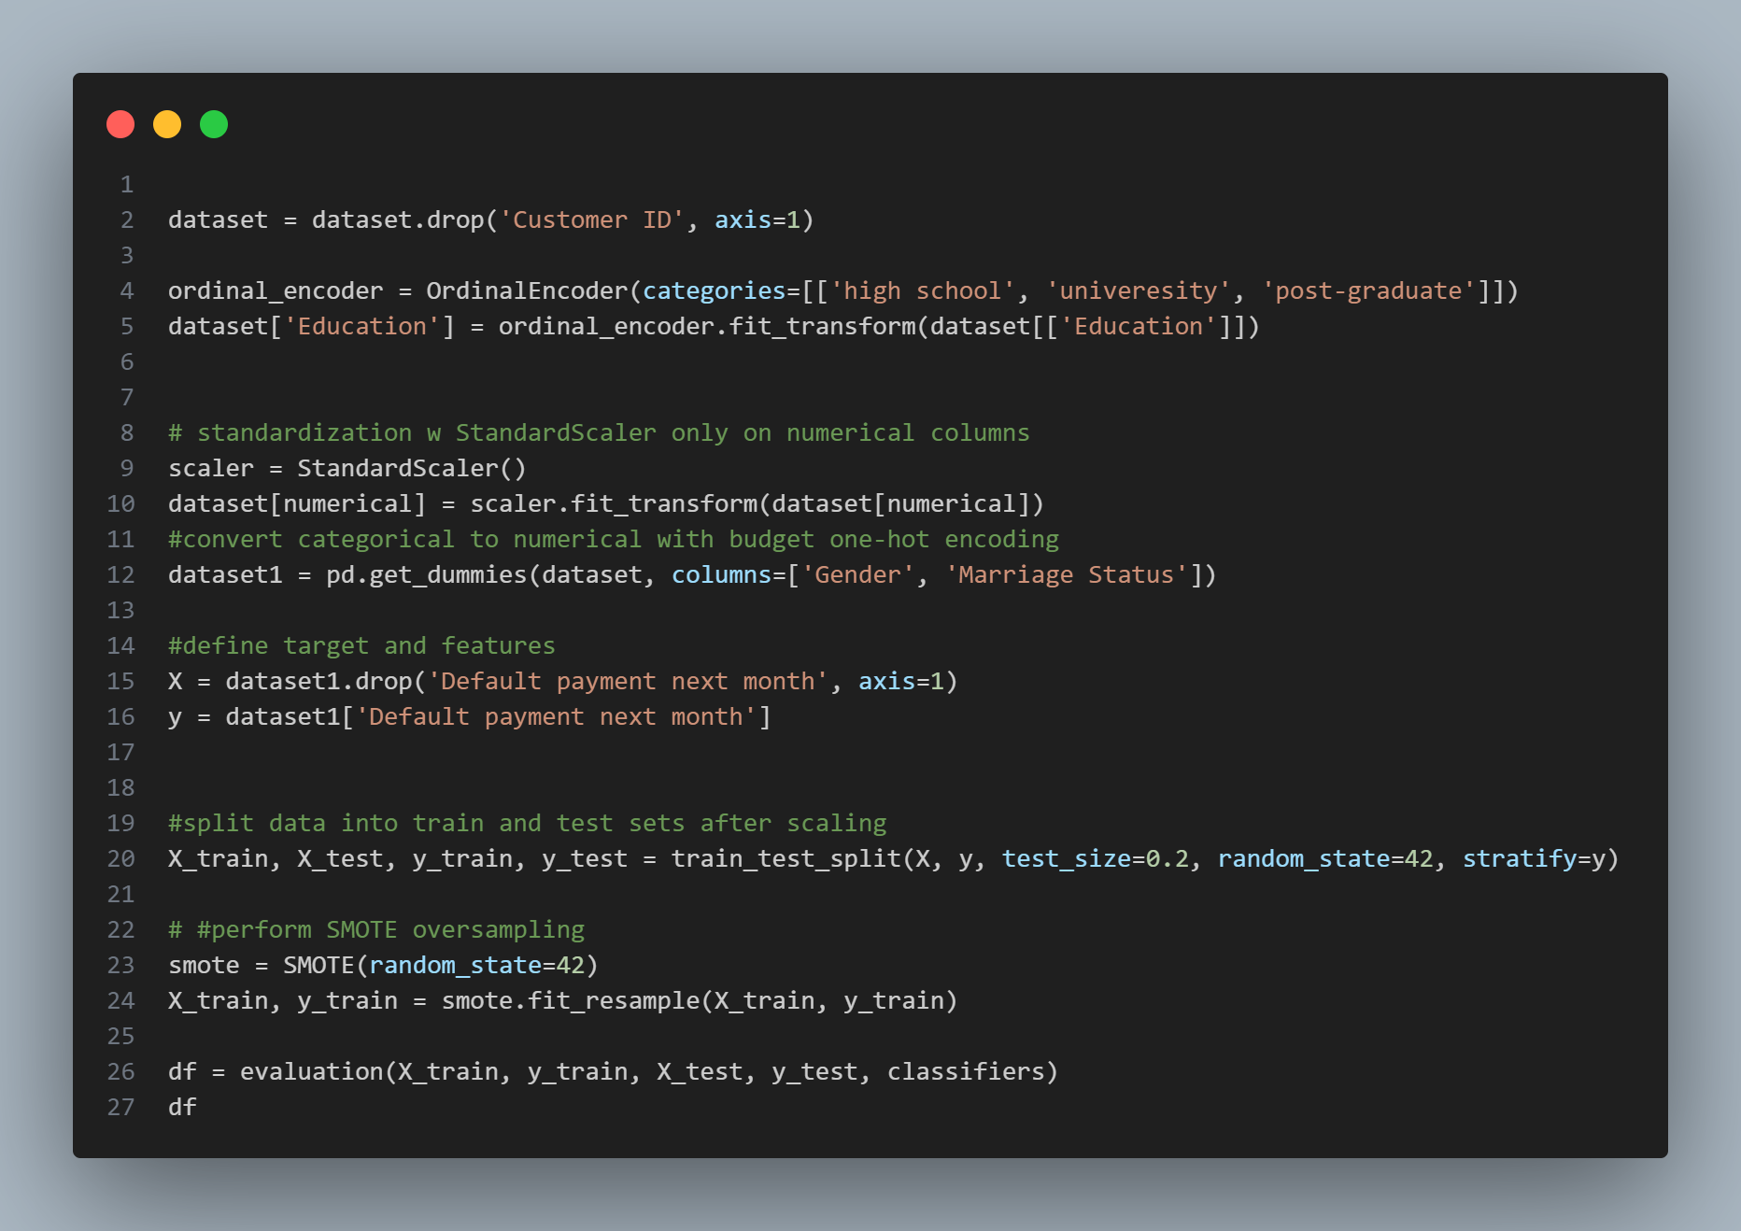
Feature engineering
1. Drop the Customer_ID column: Since the Customer_ID column does not provide valuable information for predicting the target variable and could potentially introduce noise.
2. Ordinal encoding of the Education column: If the Education column is categorical with ordinal levels (e.g., 'High School', 'Bachelor's Degree', 'Master's Degree'), we can apply ordinal encoding.
3. Apply standard scaling to numerical columns: For numerical columns like 'Credit Limit', 'Age', 'Bill_Amount1', 'Bill_Amount2', 'Bill_Amount3', 'Pay_Amount1', 'Pay_Amount2', and 'Pay_Amount3'. Standard scaling transforms the data to have a mean of 0 and a standard deviation of 1, ensuring that all features are on a similar scale. This step helps prevent features with larger magnitudes from dominating the model's learning process.
4. One-hot encoding of categorical columns: For categorical columns like Gender and Marital Status, we can apply one-hot encoding. One-hot encoding converts each category into a binary column, representing the presence or absence of that category for each data point. This step allows the model to consider the categorical variables as individual binary features.
5. Perform Smote Oversampling in order to balance the data. apply SMOTE to create synthetic samples of the minority class. This step helps prevent the model from being biased towards the majority class during training.
This transformation allows the machine learning models to capture the categorical information in a format that can be effectively utilized for prediction.

Slide 6
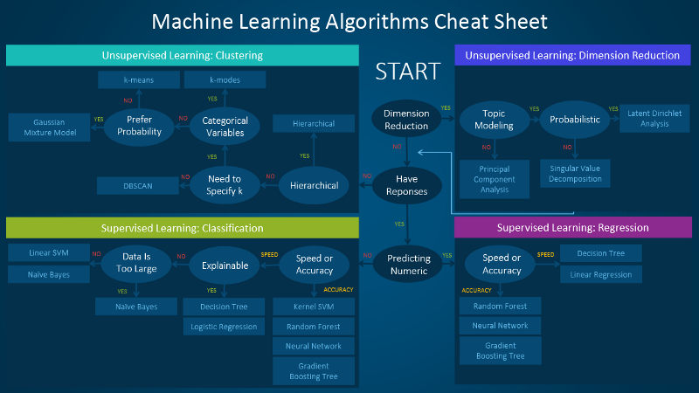
How did you select which learning algorithms to use?
By referring to the machine learning algorithm cheatsheet, the most appropriate models would be the ones in the bottom left.
I will be using Decision Tree classifier, Random Forest and GradientBoosting classifiers.
The selection of these models is justified by their individual strengths. By utilizing these models, i can benefit from their strengths to achieve accurate predictions while maintaining a reasonable level of computational efficiency.
The final model can be selected based on the performance of the models after tuning from gridsearchingc

Slide 7
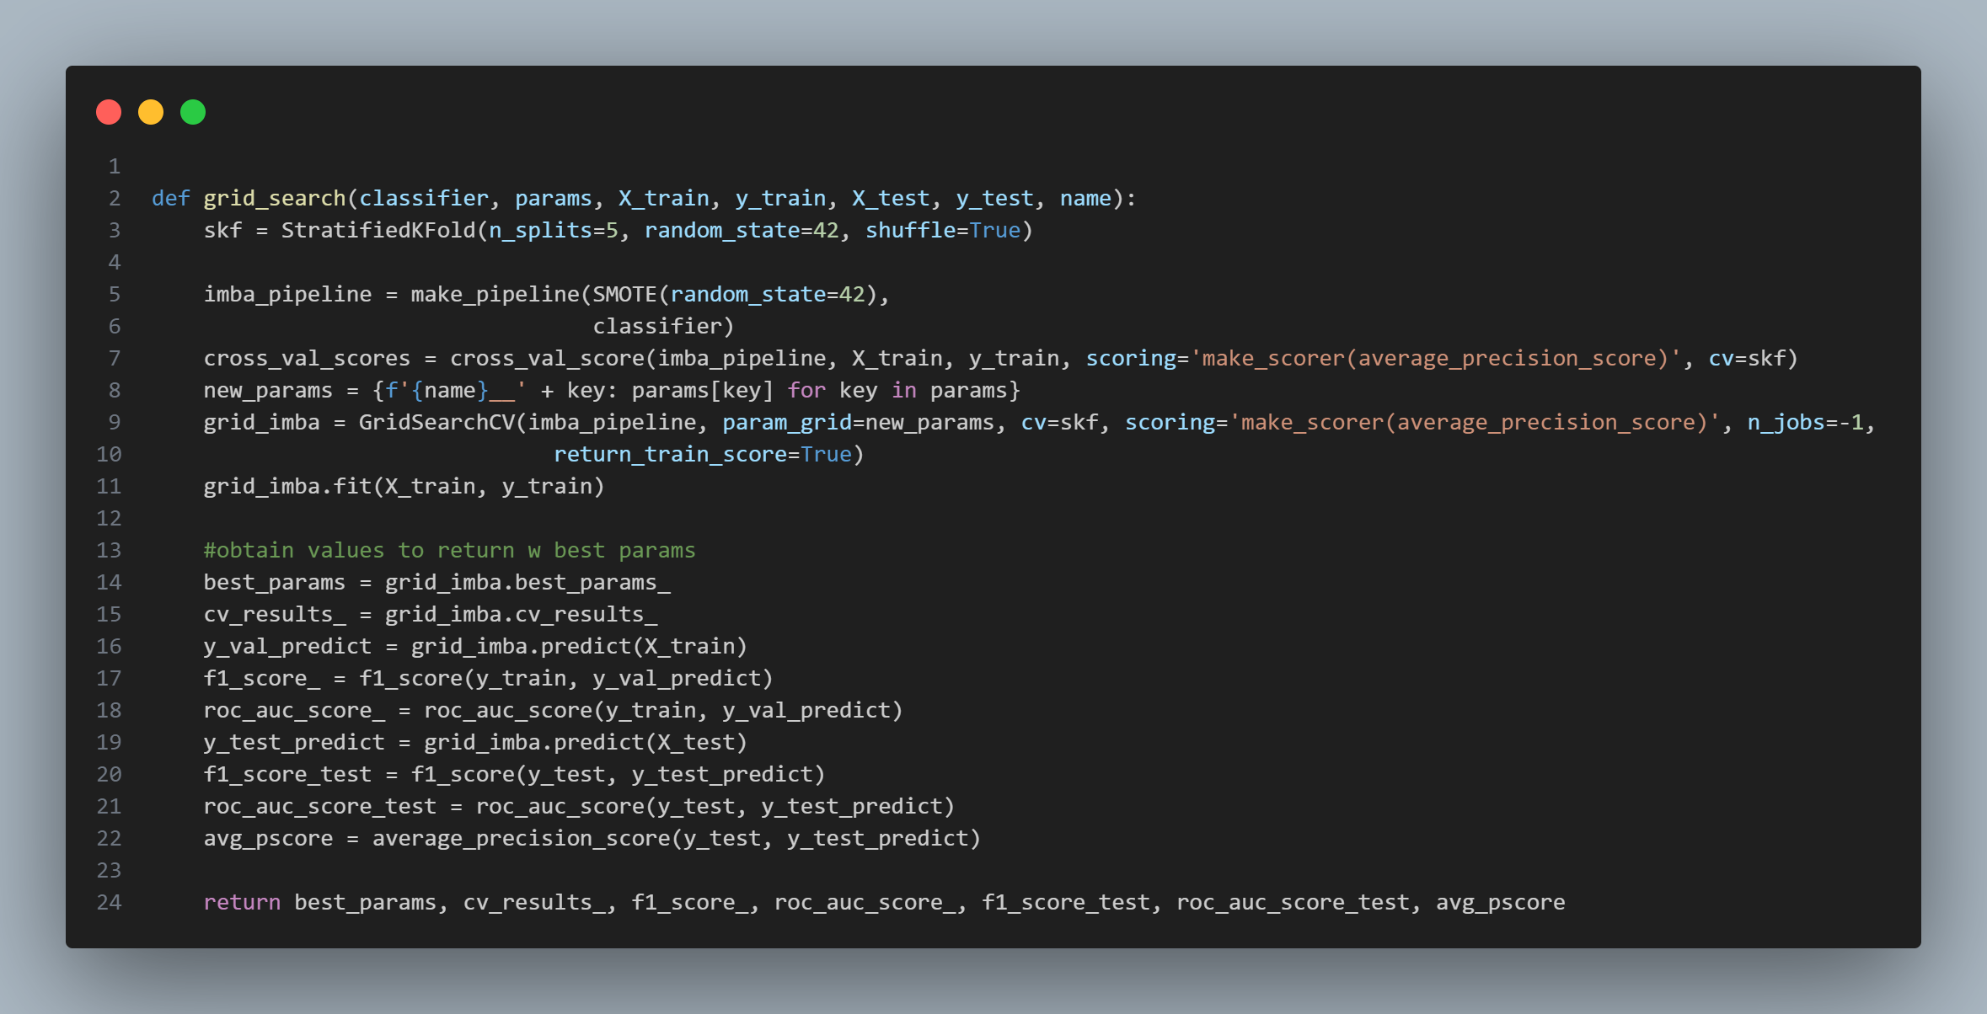
Did you try to tune the hyperparameters of the learning algorithm, and in that case how?
Hyperparameter tuning was performed using grid search for each learning algorithm. Grid search systematically explores different combinations of. The grid search was conducted using the `GridSearchCV` function, employing 5-fold cross-validation with the `StratifiedKFold` function. The best hyperparameters were determined based on the highest average precision score.
Because of how StratifiedKFold works, I will be smote the data after every fold in the gridsearch. The reason being smoting before each fold can cause data leakage from test data into validation data or vice versa, this will result in scores that are inflated and not actually representative of the actual accuracy of the model.

Slide 8
Grading/Scoring Metrics
F1 score combines precision and recall, providing a balanced assessment of system performance. It's suitable for imbalanced datasets and allows for easy model comparison.
Average Precision Score quantifies the precision-recall trade-off and is useful for imbalanced datasets.
Both metrics assess precision and recall instead of raw accuracy, making them ideal for evaluation.
However, Average precision is stricter than F1 score and sensitive to small improvements, making it suitable for performance comparison.

Slide 9
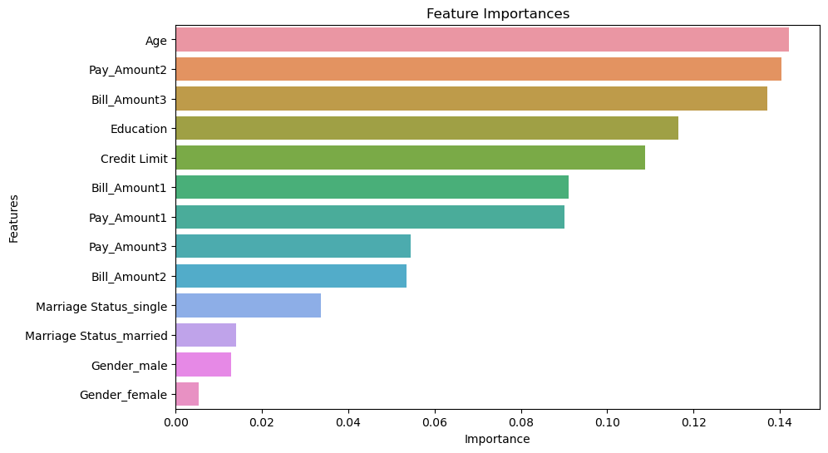
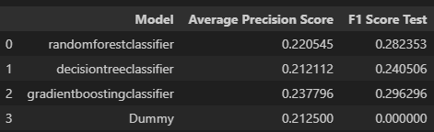

Feature Selection
Results from the gridsearch were unsatisfactory, in order to get better scores I have decided to focus solely on the best performing model, gradientboostingclassifier and use another method of hyperparameter tuning
Because of this I am able to do feature selection that is more suited for the specific model. From the graph we can see that the importance of gender and marriage status are extremely low, therefore I tried removing them and comparing the performance of the base model on the data, however I found out that that the performance of the base model has went down after removing these features, so I will be keeping them.
Grid results
Feature

Slide 10
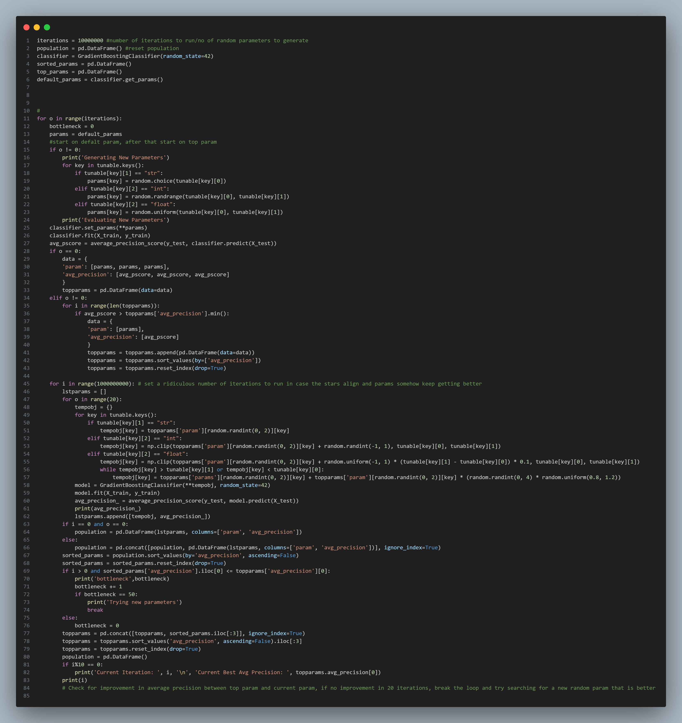
Custom Tuning
Generates random parameter sets and evaluates them based on average precision score.
The top-performing parameter sets are stored in the.
An inner loop performs a genetic algorithm-like search for further improvement.
combines randomsearching with localsearching to focus on more promising solutions.
Overall more efficient compared to GridSearch, also has the capabilities to find the global best parameter as it is not limited by size of grid. Parameters can also be generated to a higher precision.

Slide 11
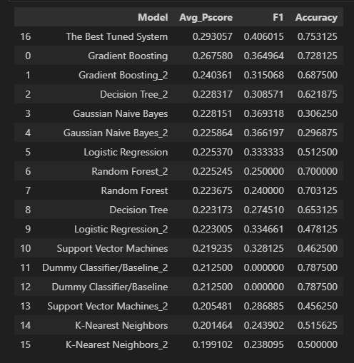
Results and evaluation
As you can see, be it Average Precision, F1 Score or Accuracy , there will be a significant increase in scores meaning the model is more accurate(quality of system increase) and compared to the dummy baseline, although lacking in accuracy(due to imbalanced dataset) i would still consider my system better as the accuracy achieved is not from randomly guessing as seen from the huge increase in f1 score and avg pscore which implies that the model is making more accurate and reliable predictions by finding the right positive cases and minimizing the wrong predictions of positive cases.

Slide 12
Can you say anything about the errors that the system makes?
Best System Confusion Matrix:
True Positives (TP): 211, False Positives (FP): 41, False Negatives (FN): 39, True Negatives (TN): 29 The best system achieved a high number of true positives, indicating that it correctly identified a significant portion of positive instances. However, it had a relatively high number of false positives, meaning it made a notable number of incorrect positive predictions. Additionally, it had a moderate number of false negatives, suggesting that it missed some positive instances. The number of true negatives was relatively low, indicating that it correctly identified negative instances to a lesser extent.
Gridsearched Confusion Matrix:
True Positives (TP): 173, False Positives (FP): 79, False Negatives (FN): 42, True Negatives (TN): 26 The gridsearched model had a lower number of true positives compared to the best system, indicating that it correctly identified fewer positive instances. It had a higher number of false positives, suggesting that it made more incorrect positive predictions. The number of false negatives was moderate, indicating that it missed a considerable number of positive instances. The true negatives were relatively low, suggesting that it correctly identified negative instances to a lesser extent.
Dummy Confusion Matrix:
True Positives (TP): 252, False Positives (FP): 0, False Negatives (FN): 68, True Negatives (TN): 0 The dummy classifier achieved a high number of true positives, indicating that it correctly identified a significant portion of positive instances. It had zero false positives, meaning it did not make any incorrect positive predictions. However, it had a high number of false negatives, suggesting that it missed a substantial number of positive instances. The number of true negatives was zero, indicating that it did not correctly identify negative instances.
In summary, the best system showed better performance compared to the gridsearched model and the dummy classifier in terms of the true positive rate and false positive rate. However, it still has room for improvement in reducing false negatives.

Slide 13
PART B: REGRESSION

Slide 14

EDA

Slide 15
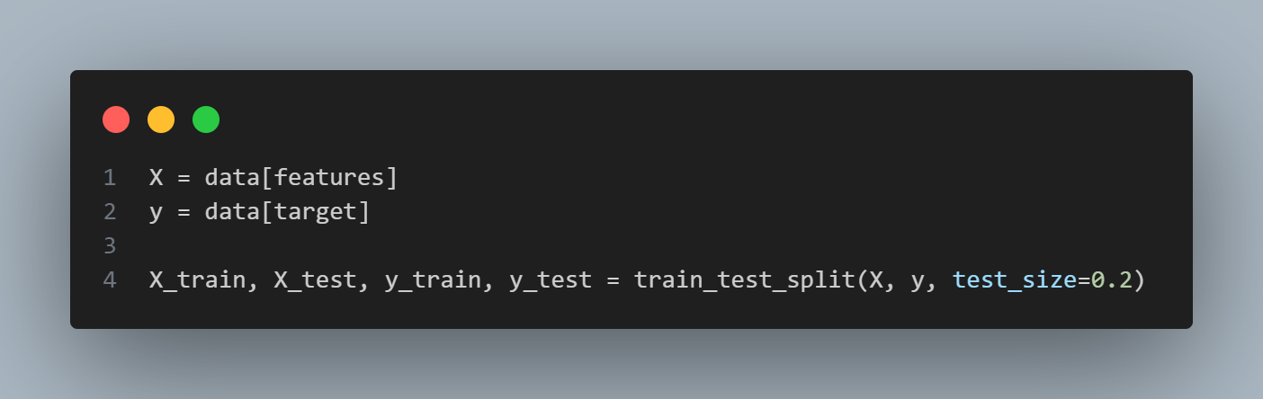
How is your prediction task defined? And what is the meaning of the output variable?
In the context of the given regression problem, the features used for predicting the price of the house include 'House Area (sqm)', 'No. of Bedrooms', 'No. of Toilets', 'Stories', 'Renovation Status', and 'City'. The target variable is the 'Price of the house', and the output variable represents the estimated/expected price of the house.
The data is initially split into two variables: 'X' for the features and 'y' for the target variable. 'X' contains the feature values, while 'y' contains the corresponding target variable values.
To assess the models' performance, the data is further divided into training and testing sets using the 'train_test_split' function from sklearn. The training set is used to train the regression models, enabling them to learn the patterns and relationships between the features and the target variable. The testing set is then employed to evaluate how well the trained models generalize to unseen data.
The objective of training these regression models is to predict the value of the target variable ('y') based on the given features ('X'). The models' output will be the expected price of the house, reflecting their ability to estimate the target variable value accurately.
By training and evaluating different regression models using these features, the aim is to identify the most effective model that can provide accurate predictions of the house prices.

Slide 16
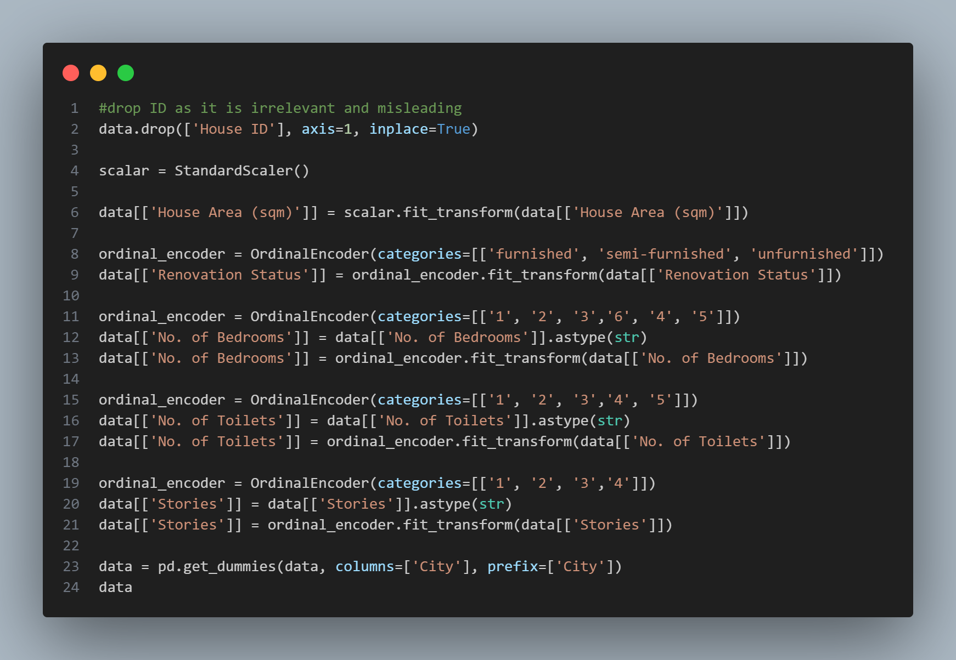
Feature Engineering
First, the irrelevant 'House ID' column was dropped from the dataset as it does not provide any valuable insights for the regression models.
Next, the numerical feature 'House area' was scaled using a standard scaler. This scaling technique ensures that all numerical features are on a similar scale, preventing any particular feature from dominating the regression models' learning process due to its larger magnitude.
For the categorical feature 'City', one-hot encoding was applied. which allows the regression models to effectively utilize the city information for predicting house prices.
Regarding the ordinal categorical data, ordinal encoding was performed. Ordinal encoding assigns numerical labels to categories based on their order or rank.
However, it's important to note that the number of toilets feature was not properly ordered, as identified during the exploratory data analysis (EDA). Hence, special attention should be given to the encoding of this particular feature to ensure it is represented accurately in the regression models.
Overall, these preprocessing steps ensure that the features are appropriately processed and ready for regression modeling, improving the models' ability to learn meaningful relationships and make accurate predictions.

Slide 17
How did you select which learning algorithms to use?
By referring to the machine learning algorithm cheatsheet, the most appropriate models would be the ones in the bottom right.
Because of how I used more accurate models for classification I wanted to try out some of the faster models this time for regression
Due to the nature of regression, the models tend to run extremely fast so this time I could put multiple models through more intensive tuning and still be done relatively quickly. This is why I picked not only the fast models from the cheat sheet, I also used some other models that I found online.
These models include
Ridge Regression
Linear Regression
Support Vector Regression
K-Nearest Neighbors Regression
Lasso Regression
ElasticNet Regression
Decision Tree Regression

Slide 18
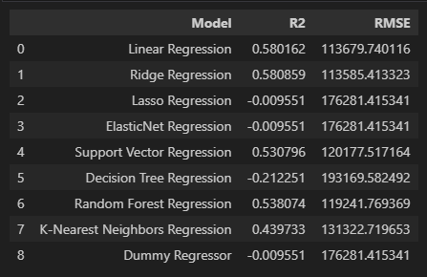
Evaluation Metrics
There are many popular Metrics used for Scoring Regression models, these include RMSE, MSE, MAE and R2
However for the ease of interpretation I will be mainly focusing on R2 but I will still be scoring models based on RMSE to check the error rate of each model
The reasoning behind this is mainly because of ease of interpretability, R2 is a simple scale of accuracy with 1 being the best score and 0 being the baseline. RMSE is easier to interpret compared to MSE the numbers are not as large

Slide 19
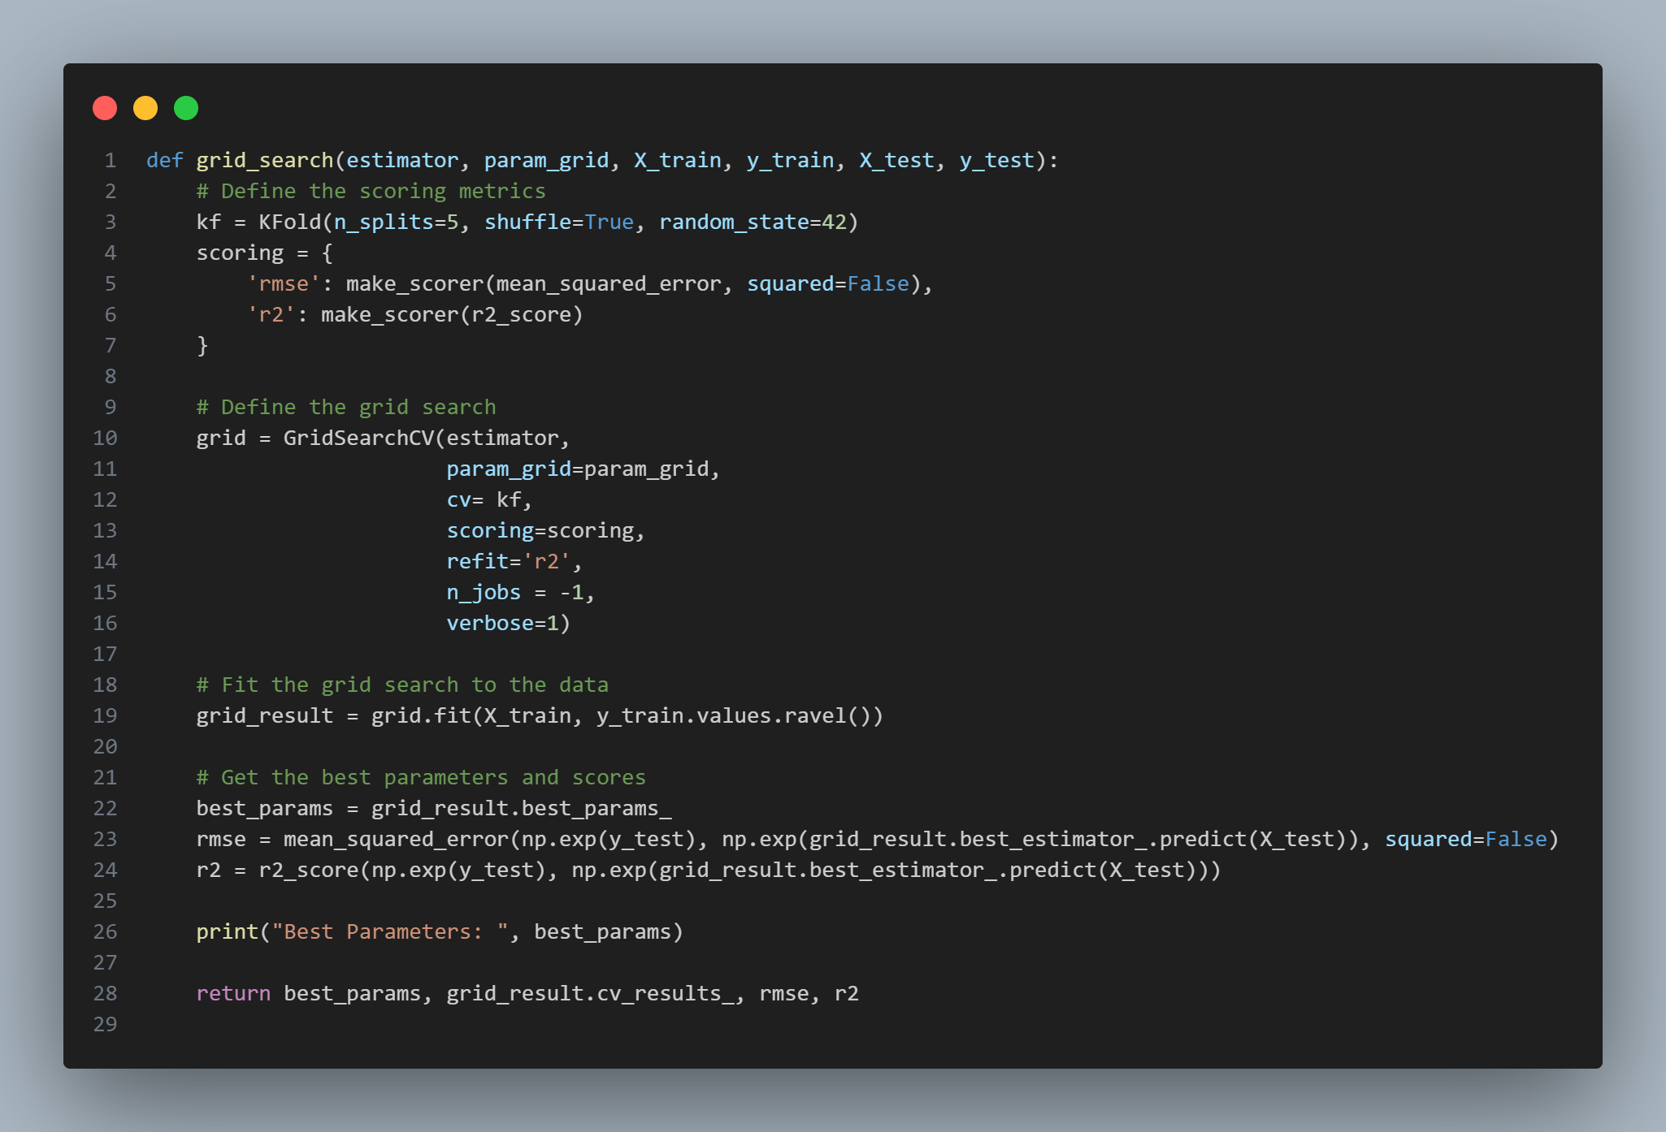
Hyperparameter tuning
For tuning, I did a simple grid search followed by the modified version of my custom tuning method for classification.
The reason as to why this is different from the classification gridsearch is because there is no need for the pipeline as oversampling is not needed on the regression data

Slide 20
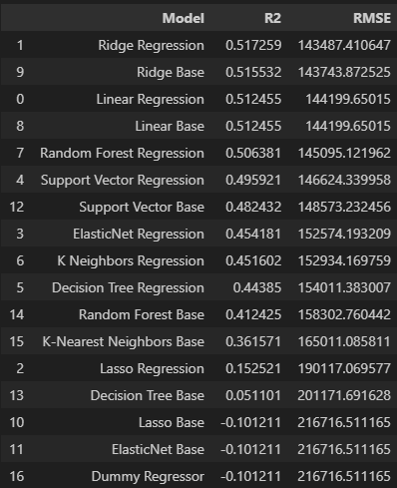
Custom Hyperparameter Tuning
My reasoning for tuning multiple models is because of the increase that I saw from the gridsearch, many of the models that had low scores from their base parameters had a sudden increase(e.g. ElasticNet ,DTC, Lasso), this made tuning only the best performing model more illogical which is why I am tuning multiple models
Changes that I have applied:
Added a loop to iterate through the tunable areas for each classifier as I am tuning multiple models now and not just GradientBoostingClassifier
2. Added actual iterations that scales off of number of parameters in the tunable space instead of an extremely large number, this so that the external model loop actually works

Slide 21
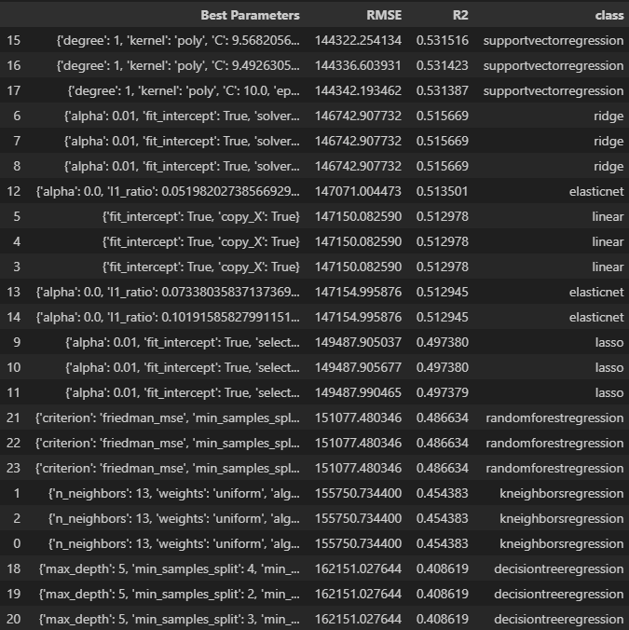
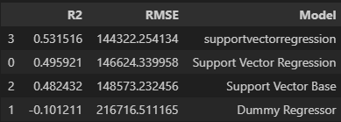
Final Evaluation
From these models, we can easily select the best performing one by sorting the R2 score by descending or RMSE by ascending.
From these models, we can easily select the best performing one by sorting the R2 score by descending or RMSE by ascending.
SVR has the lowest RMSE and the highest R2 score, indicating better predictive performance and a better fit to the data. we can now compare to some other models, for example the untuned model, dummy classifier as well as gridsearched model.

Slide 22
Errors made
From the provided data, we can compare the errors made by each regressor based on the RMSE (Root Mean Square Error) values:
Tuned SVR:
RMSE: 144,322.254134
Support Vector Regression:
RMSE: 146,624.339958
Support Vector Base:
RMSE: 148,573.232456
Dummy Regressor:
RMSE: 216,716.511165
Comparing the RMSE values, we can observe that the Tuned SVR has the lowest error, followed by Grid Searched SVR( Support Vector Regression), Support Vector Base , and Dummy Regressor . Lower RMSE values indicate better performance and less errors, this shows that the best System makes less errors compared to the other systems

